Slide 1

DIVINE GRACE COLLEGE OF ARTS, SCIENCE AND TECHNOLOGY
(DGCAST) — GAROUA | GEOGRAPHY DEPARTMENT
UPPER SIXTH ARTS — PRACTICAL GEOGRAPHY — MAP ANALYSIS 1
Review of Map Reading Principles
Mr KAMDEM EMMANUEL
Geography Teacher — PLEG
Academic Year 2026 / 2027
Notes:
Good morning, class. Today we study Map Analysis 1: Review of Map Reading Principles.

Slide 2
GEOGRAPHY — UPPER SIXTH ARTS
CLASS INFO
Class, Chapter & Duration
Class | Upper Sixth Arts
Chapter | Module 8: Understanding and carrying out statistical techniques, topographic map analysis, fieldwork and project based learning
Duration | 2 periods (2 × 50 minutes)
2026 / 2027
DGCAST GAROUA — GEOGRAPHY DEPARTMENT
Mr KAMDEM E. | 2

Slide 3
GEOGRAPHY — UPPER SIXTH ARTS
IDENTIFICATION
Lesson Identification
Topic | Topographic Map Analysis
Sub-topic | Review of map reading of the first cycle
Lesson | Map Analysis 1: Review of Map Reading Principles
Notions / Concepts | Topographic map, conventional sign, key, scale, grid reference, contour, spot height.
Syllabus focus | Conventional signs and symbols and the key; scales and map measurements; principles of contours.
Competence | Learners are able to read signs, measure distances and give grid references on a topographic map.
2026 / 2027
DGCAST GAROUA — GEOGRAPHY DEPARTMENT
Mr KAMDEM E. | 3

Slide 4
GEOGRAPHY — UPPER SIXTH ARTS
OBJECTIVES
Learning Objectives
By the end of the lesson, the learner should be able to:
Use the key to identify conventional signs.
Measure distances with the scale.
Give six-figure grid references and read contours.
2026 / 2027
DGCAST GAROUA — GEOGRAPHY DEPARTMENT
Mr KAMDEM E. | 4

Slide 5
GEOGRAPHY — UPPER SIXTH ARTS
RECALL
Recall
A map is a drawing of the Earth on a flat surface.
The key explains the symbols.
2026 / 2027
DGCAST GAROUA — GEOGRAPHY DEPARTMENT
Mr KAMDEM E. | 5

Slide 6
GEOGRAPHY — UPPER SIXTH ARTS
REAL-LIFE SITUATION
Real-Life Situation
The class receives a 1:50,000 map extract of an area near Mbé. The teacher asks them to find the village, measure the road from A to B and give the height of the highest hill.
2026 / 2027
DGCAST GAROUA — GEOGRAPHY DEPARTMENT
Mr KAMDEM E. | 6
Notes:
Read the situation slowly, twice.

Slide 7
GEOGRAPHY — UPPER SIXTH ARTS
REAL-LIFE SITUATION
Situation — Question 1
What is the problem in the situation?
2026 / 2027
DGCAST GAROUA — GEOGRAPHY DEPARTMENT
Mr KAMDEM E. | 7

Slide 8
GEOGRAPHY — UPPER SIXTH ARTS
REAL-LIFE SITUATION
Answer
The class must read and measure on a map.
2026 / 2027
DGCAST GAROUA — GEOGRAPHY DEPARTMENT
Mr KAMDEM E. | 8

Slide 9
GEOGRAPHY — UPPER SIXTH ARTS
REAL-LIFE SITUATION
Situation — Question 2
What helps to identify symbols?
2026 / 2027
DGCAST GAROUA — GEOGRAPHY DEPARTMENT
Mr KAMDEM E. | 9

Slide 10
GEOGRAPHY — UPPER SIXTH ARTS
REAL-LIFE SITUATION
Answer
The key (legend).
2026 / 2027
DGCAST GAROUA — GEOGRAPHY DEPARTMENT
Mr KAMDEM E. | 10

Slide 11
GEOGRAPHY — UPPER SIXTH ARTS
REAL-LIFE SITUATION
Situation — Question 3
What shows the height of land?
2026 / 2027
DGCAST GAROUA — GEOGRAPHY DEPARTMENT
Mr KAMDEM E. | 11

Slide 12
GEOGRAPHY — UPPER SIXTH ARTS
REAL-LIFE SITUATION
Possible Answer
Contours and spot heights.
2026 / 2027
DGCAST GAROUA — GEOGRAPHY DEPARTMENT
Mr KAMDEM E. | 12

Slide 13
GEOGRAPHY — UPPER SIXTH ARTS
JUSTIFICATION
Justification of the Lesson
This lesson revises the basic skills needed for all map analysis.
2026 / 2027
DGCAST GAROUA — GEOGRAPHY DEPARTMENT
Mr KAMDEM E. | 13

Slide 14

GEOGRAPHY — UPPER SIXTH ARTS
I. SIGNS AND KEY
Activity 1
Conventional signs.
2026 / 2027
DGCAST GAROUA — GEOGRAPHY DEPARTMENT
Mr KAMDEM E. | 14
Notes:
Without the projector: draw five signs.

Slide 15
GEOGRAPHY — UPPER SIXTH ARTS
I. SIGNS AND KEY
Activity 1: Question
Why are conventional signs used on maps?
2026 / 2027
DGCAST GAROUA — GEOGRAPHY DEPARTMENT
Mr KAMDEM E. | 15

Slide 16
GEOGRAPHY — UPPER SIXTH ARTS
I. SIGNS AND KEY
Answer
To show many features in a small space in a standard way.
2026 / 2027
DGCAST GAROUA — GEOGRAPHY DEPARTMENT
Mr KAMDEM E. | 16

Slide 17
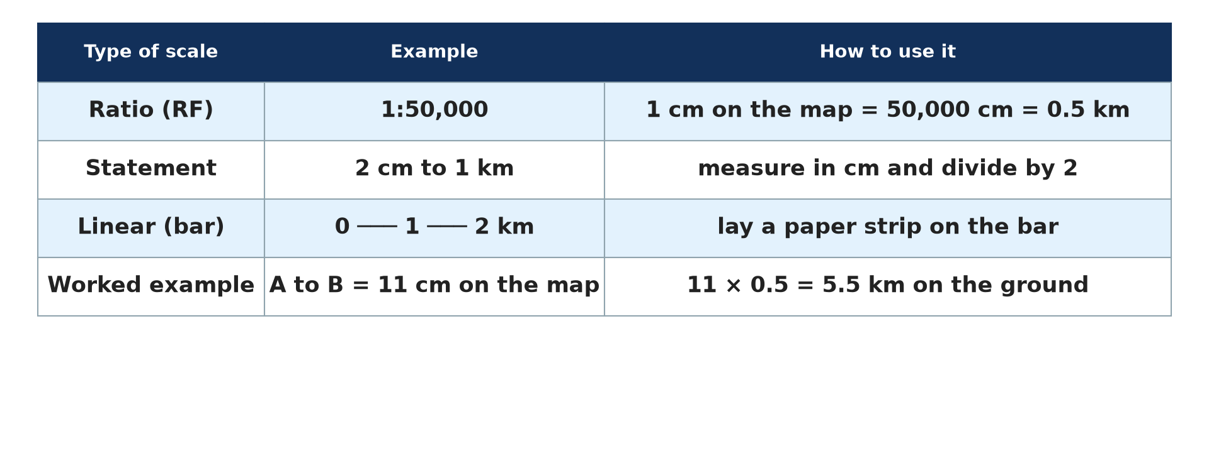
GEOGRAPHY — UPPER SIXTH ARTS
II. SCALE
Activity 2
Types of scale.
2026 / 2027
DGCAST GAROUA — GEOGRAPHY DEPARTMENT
Mr KAMDEM E. | 17
Notes:
Without the projector: convert scales.

Slide 18
GEOGRAPHY — UPPER SIXTH ARTS
II. SCALE
Activity 2: Question
On a 1:50,000 map, A to B measures 9 cm. What is the real distance?
2026 / 2027
DGCAST GAROUA — GEOGRAPHY DEPARTMENT
Mr KAMDEM E. | 18

Slide 19
GEOGRAPHY — UPPER SIXTH ARTS
II. SCALE
Answer
9 × 0.5 = 4.5 km.
2026 / 2027
DGCAST GAROUA — GEOGRAPHY DEPARTMENT
Mr KAMDEM E. | 19

Slide 20
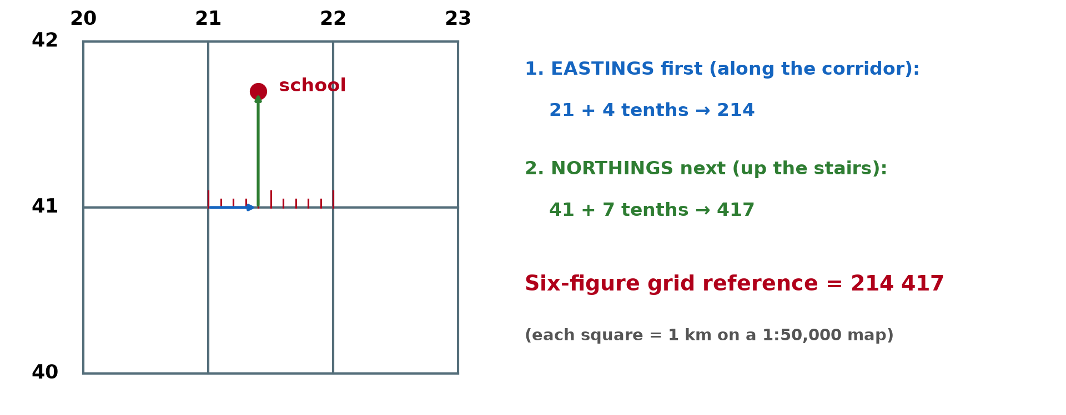
GEOGRAPHY — UPPER SIXTH ARTS
II. GRID REFERENCES
Activity 3
A six-figure grid reference.
2026 / 2027
DGCAST GAROUA — GEOGRAPHY DEPARTMENT
Mr KAMDEM E. | 20
Notes:
Without the projector: give the reference of a point.

Slide 21
GEOGRAPHY — UPPER SIXTH ARTS
II. GRID REFERENCES
Activity 3: Question
Which comes first in a grid reference, eastings or northings?
2026 / 2027
DGCAST GAROUA — GEOGRAPHY DEPARTMENT
Mr KAMDEM E. | 21

Slide 22
GEOGRAPHY — UPPER SIXTH ARTS
II. GRID REFERENCES
Answer
Eastings first, then northings.
2026 / 2027
DGCAST GAROUA — GEOGRAPHY DEPARTMENT
Mr KAMDEM E. | 22

Slide 23
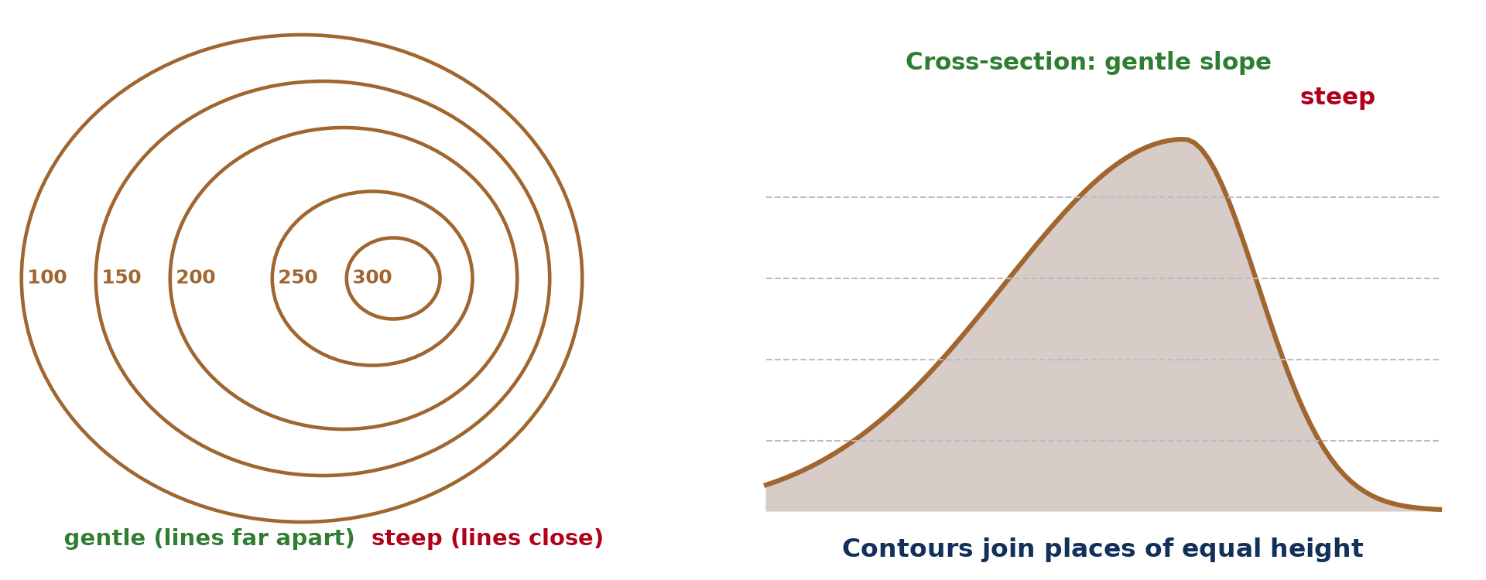
GEOGRAPHY — UPPER SIXTH ARTS
III. CONTOURS
Activity 4
Contours and slopes.
2026 / 2027
DGCAST GAROUA — GEOGRAPHY DEPARTMENT
Mr KAMDEM E. | 23
Notes:
Without the projector: compare spacing.

Slide 24
GEOGRAPHY — UPPER SIXTH ARTS
III. CONTOURS
Activity 4: Question
What do closely spaced contours show?
2026 / 2027
DGCAST GAROUA — GEOGRAPHY DEPARTMENT
Mr KAMDEM E. | 24

Slide 25
GEOGRAPHY — UPPER SIXTH ARTS
III. CONTOURS
Answer
A steep slope.
2026 / 2027
DGCAST GAROUA — GEOGRAPHY DEPARTMENT
Mr KAMDEM E. | 25

Slide 26
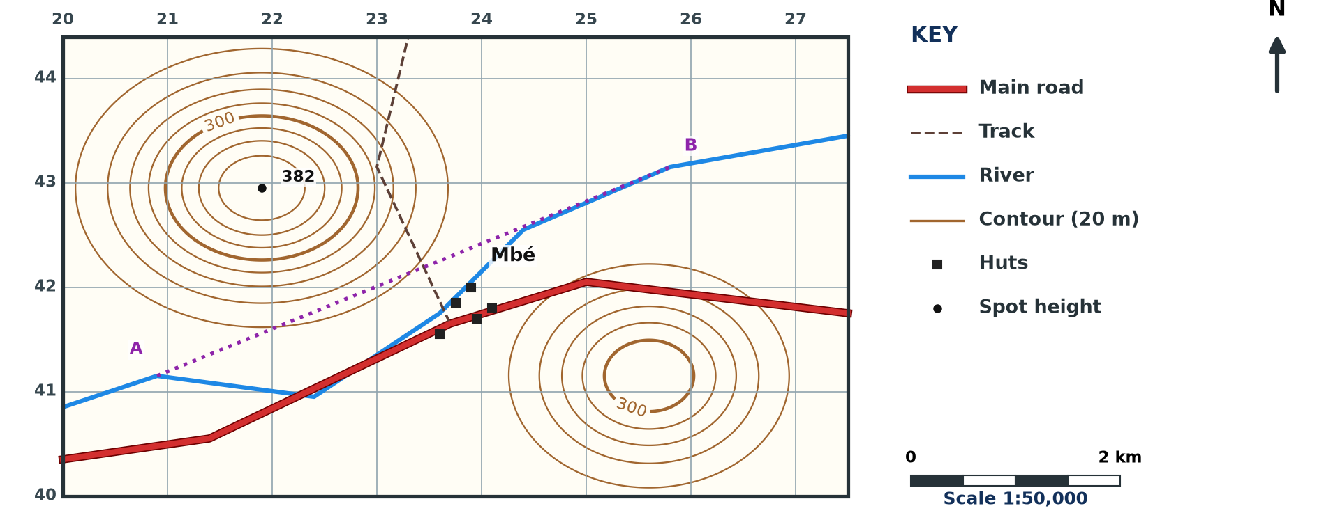
GEOGRAPHY — UPPER SIXTH ARTS
III. APPLICATION
Activity 5
A map extract (invented, 1:50,000).
2026 / 2027
DGCAST GAROUA — GEOGRAPHY DEPARTMENT
Mr KAMDEM E. | 26
Notes:
Without the projector: read the extract.

Slide 27
GEOGRAPHY — UPPER SIXTH ARTS
III. APPLICATION
Activity 5: Question
Give the height of the spot height and the direction of Mbé from it.
2026 / 2027
DGCAST GAROUA — GEOGRAPHY DEPARTMENT
Mr KAMDEM E. | 27

Slide 28
GEOGRAPHY — UPPER SIXTH ARTS
III. APPLICATION
Answer
382 m; Mbé is south-east of the spot height.
2026 / 2027
DGCAST GAROUA — GEOGRAPHY DEPARTMENT
Mr KAMDEM E. | 28

Slide 29
GEOGRAPHY — UPPER SIXTH ARTS
BOARD SUMMARY
Review of Map Reading Principles
Topic: Topographic Map Analysis
Sub-topic: Review of map reading of the first cycle
Map Analysis 1: Review of Map Reading Principles
2026 / 2027
DGCAST GAROUA — GEOGRAPHY DEPARTMENT
Mr KAMDEM E. | 29
Notes:
Learners copy the board summary now. Give them enough time for each slide.

Slide 30
GEOGRAPHY — UPPER SIXTH ARTS
BOARD SUMMARY
I. Definitions
Topographic map: It is a detailed map showing relief, drainage, vegetation and human features.
Scale: It is the ratio between a distance on the map and the real distance on the ground.
Contour: It is a line joining places of the same height above sea level.
2026 / 2027
DGCAST GAROUA — GEOGRAPHY DEPARTMENT
Mr KAMDEM E. | 30

Slide 31
GEOGRAPHY — UPPER SIXTH ARTS
BOARD SUMMARY
II. Signs, Scale and Grid References (1/3)
A. Signs: Conventional signs show roads, rivers, huts and vegetation. The key explains each sign.
B. Scale: Scales can be a ratio, a statement or a linear bar. On a 1:50,000 map, 2 cm represent 1 km.
2026 / 2027
DGCAST GAROUA — GEOGRAPHY DEPARTMENT
Mr KAMDEM E. | 31

Slide 32
GEOGRAPHY — UPPER SIXTH ARTS
BOARD SUMMARY
II. Signs, Scale and Grid References (2/3)
C. Grid references: Read eastings first, then northings, with tenths of a square. A six-figure reference locates a point to 100 m.
2026 / 2027
DGCAST GAROUA — GEOGRAPHY DEPARTMENT
Mr KAMDEM E. | 32

Slide 33
GEOGRAPHY — UPPER SIXTH ARTS
BOARD SUMMARY
II. Signs, Scale and Grid References (3/3)
Copy the method.
2026 / 2027
DGCAST GAROUA — GEOGRAPHY DEPARTMENT
Mr KAMDEM E. | 33

Slide 34
GEOGRAPHY — UPPER SIXTH ARTS
BOARD SUMMARY
III. Contours
A. Principles: Contours never cross and are drawn at a fixed vertical interval. Heights are written on index contours.
B. Slopes: Close contours show steep slopes and wide spacing shows gentle slopes. Spot heights give exact heights.
2026 / 2027
DGCAST GAROUA — GEOGRAPHY DEPARTMENT
Mr KAMDEM E. | 34

Slide 35
GEOGRAPHY — UPPER SIXTH ARTS
FORMATIVE EVALUATION
Formative Evaluation 1
Convert 1:50,000 into a statement scale.
2026 / 2027
DGCAST GAROUA — GEOGRAPHY DEPARTMENT
Mr KAMDEM E. | 35

Slide 36
GEOGRAPHY — UPPER SIXTH ARTS
FORMATIVE EVALUATION
Expected Answer
2 cm represent 1 km.
2026 / 2027
DGCAST GAROUA — GEOGRAPHY DEPARTMENT
Mr KAMDEM E. | 36

Slide 37
GEOGRAPHY — UPPER SIXTH ARTS
FORMATIVE EVALUATION
Formative Evaluation 2
State two principles of contours.
2026 / 2027
DGCAST GAROUA — GEOGRAPHY DEPARTMENT
Mr KAMDEM E. | 37

Slide 38
GEOGRAPHY — UPPER SIXTH ARTS
FORMATIVE EVALUATION
Expected Answer
They join equal heights and never cross.
2026 / 2027
DGCAST GAROUA — GEOGRAPHY DEPARTMENT
Mr KAMDEM E. | 38

Slide 39
GEOGRAPHY — UPPER SIXTH ARTS
REMEDIATION
Remediation
Fill in the blanks:
The ______ explains map symbols.
Eastings are read ______.
Close contours show a ______ slope.
2026 / 2027
DGCAST GAROUA — GEOGRAPHY DEPARTMENT
Mr KAMDEM E. | 39
Notes:
Answers: 1. key 2. first 3. steep

Slide 40
GEOGRAPHY — UPPER SIXTH ARTS
HOMEWORK
Homework
Draw a map of your school with a key, a scale and a north arrow.
This prepares Map Analysis 2: Remote Sensing and GIS.
2026 / 2027
DGCAST GAROUA — GEOGRAPHY DEPARTMENT
Mr KAMDEM E. | 40
Notes:
This homework prepares the next lesson.

Slide 41
GEOGRAPHY — UPPER SIXTH ARTS
BILINGUAL GAME
Bilingual Game (Jeu Bilingue)
English | Français
Map | La carte
Key | La légende
Scale | L'échelle
Contour | La courbe de niveau
Grid reference | Les coordonnées
Spot height | Le point coté
2026 / 2027
DGCAST GAROUA — GEOGRAPHY DEPARTMENT
Mr KAMDEM E. | 41
Notes:
Say the English word; learners give the French word, then the reverse.

Slide 42
GEOGRAPHY — UPPER SIXTH ARTS
LOGBOOK
Official Logbook (1/2)
Module / Topic | Topographic Map Analysis
Lesson Title | Map Analysis 1: Review of Map Reading Principles
Expected Learning Outcomes | Use the key to identify conventional signs. Measure distances with the scale. Give six-figure grid references and read contours.
Competence | Learners are able to read signs, measure distances and give grid references on a topographic map.
2026 / 2027
DGCAST GAROUA — GEOGRAPHY DEPARTMENT
Mr KAMDEM E. | 42

Slide 43
GEOGRAPHY — UPPER SIXTH ARTS
LOGBOOK
Official Logbook (2/2)
Matter Taught | I. Definitions: Topographic map, Scale, Contour; II. Signs, Scale and Grid References: Signs, Scale, Grid references; III. Contours: Principles, Slopes.
Evaluation | Formative evaluation (3 questions) and remediation exercise.
Homework | Draw a map of your school with a key, a scale and a north arrow.
Enrolment / Present / Absent | ____ / ____ / ____
Achievement | To be completed by the teacher after the lesson.
2026 / 2027
DGCAST GAROUA — GEOGRAPHY DEPARTMENT
Mr KAMDEM E. | 43

Slide 44
GEOGRAPHY — UPPER SIXTH ARTS
TEACHER'S NOTE
Teacher's Note
Timing: Set-up, recall 8 min | Situation 8 min | 5 activities 30 min | Board summary (copying) 30 min | Evaluation, remediation 10 min | Homework, logbook 9 min | Spare 5 min
2026 / 2027
DGCAST GAROUA — GEOGRAPHY DEPARTMENT
Mr KAMDEM E. | 44

Slide 45
GEOGRAPHY — UPPER SIXTH ARTS
REFERENCES
References
National Geography Syllabus, Sixth Forms (Lower & Upper Sixth), MINESEC/IGE/IP-SS, August 2019 — Module 8 (Practical Geography).
Diagrams and animations: drawn for this lesson (DGCAST Geography Department).
2026 / 2027
DGCAST GAROUA — GEOGRAPHY DEPARTMENT
Mr KAMDEM E. | 45

